Slide 1

Opioid releated disorder
Maryam shakeel.
Roll No 2167
Psychopathology

Slide 2
OPIOID releated disorder OPIOID use disorder OPIOID intoxIation OPIOID withdrawal

Slide 3
Opioid use disorder
A problematic pattern of opioid use leading clinal significance important or distress as manifested by at least two following, 12 month period .
11 to 12 symptoms in total highlight someone .
Opioid are often taken in large amounts over a longer period than was intended.
Unsuccessful efforts to cut down or control opioid use
Craving
Tolerance
Withdrawal

Slide 4
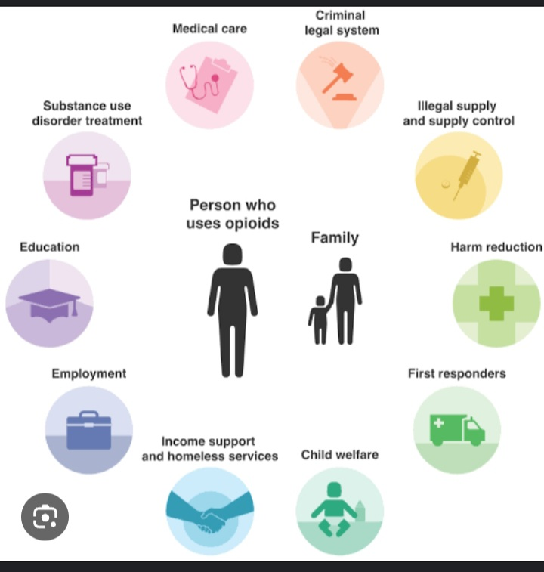

Slide 5
Opioid intoxication
Recent use of an opioid .
Clinically significant problematic behavioral and psychological changes that develop occurs or shortly after opioid use .
Drowsiness or coma.
Slurred speech .
Impairment in attention or memory .
The sign and symptoms are not attributable to another condition or intonation with another substance.

Slide 6
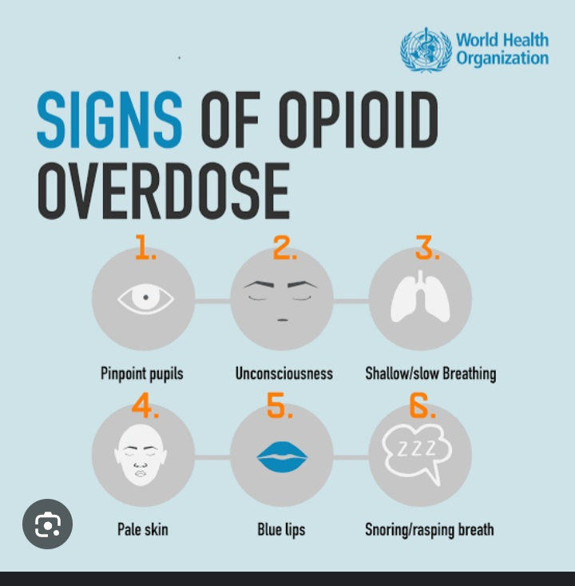

Slide 7
OPIOID WITHDRAWAL
Presence of either of the following.
Cessation of an opioid use that has been heavy and prolonged .
physicalogical am d psychological symptoms.
Administration of an opioid antagonist after a period use .
Dsyphoric mood
Muscle ache .
Vomiting
Fever ,sweating etc .

Slide 8
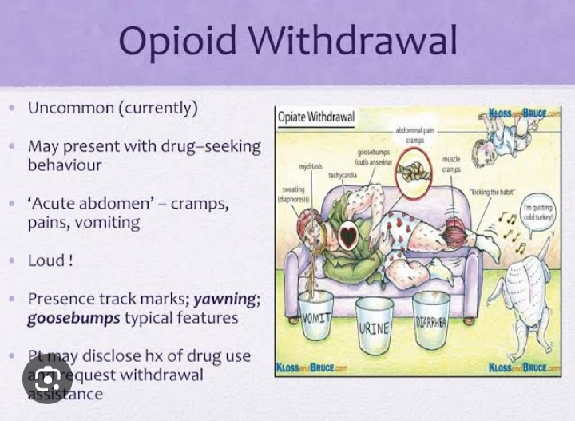

Slide 9
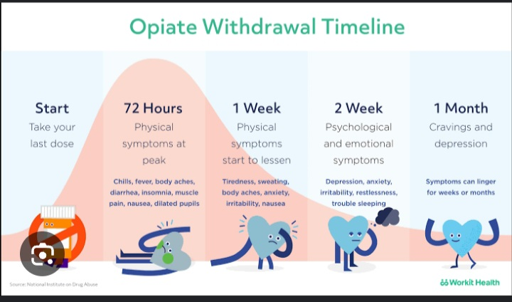
Duration. And symptoms

